Slide 1

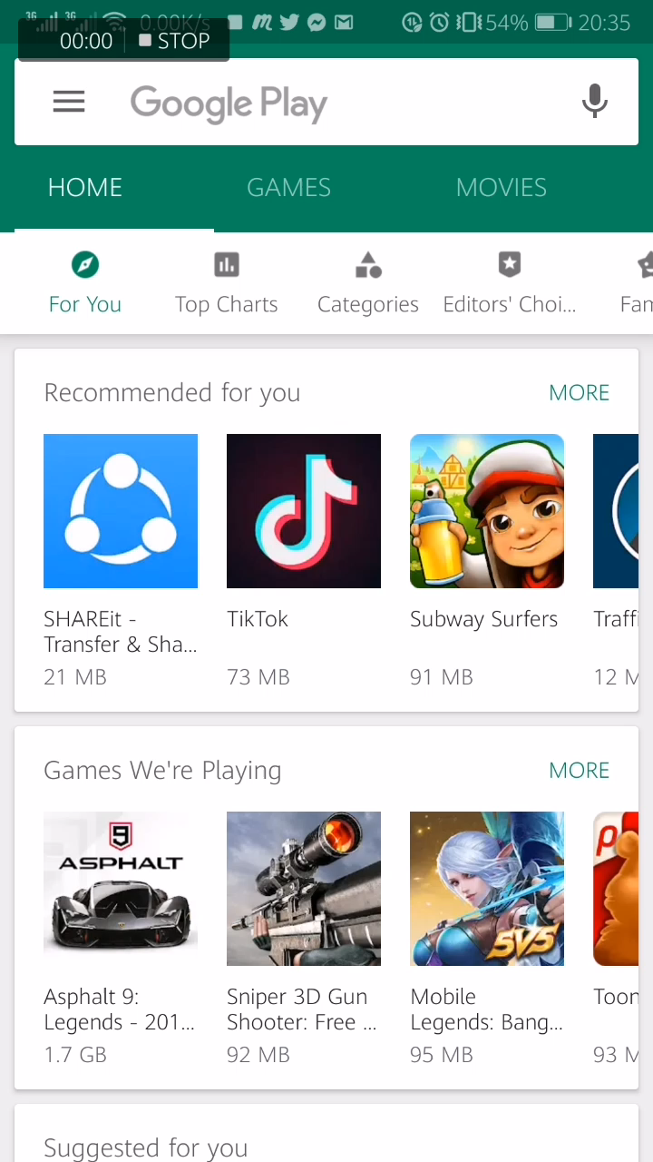
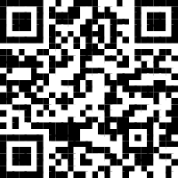
DON’T WANNA SEARCH? SCAN THE QR FROM EXPO!
SSID:DEVCONMU2019
PASSWORD: DevConAccess4

Slide 2
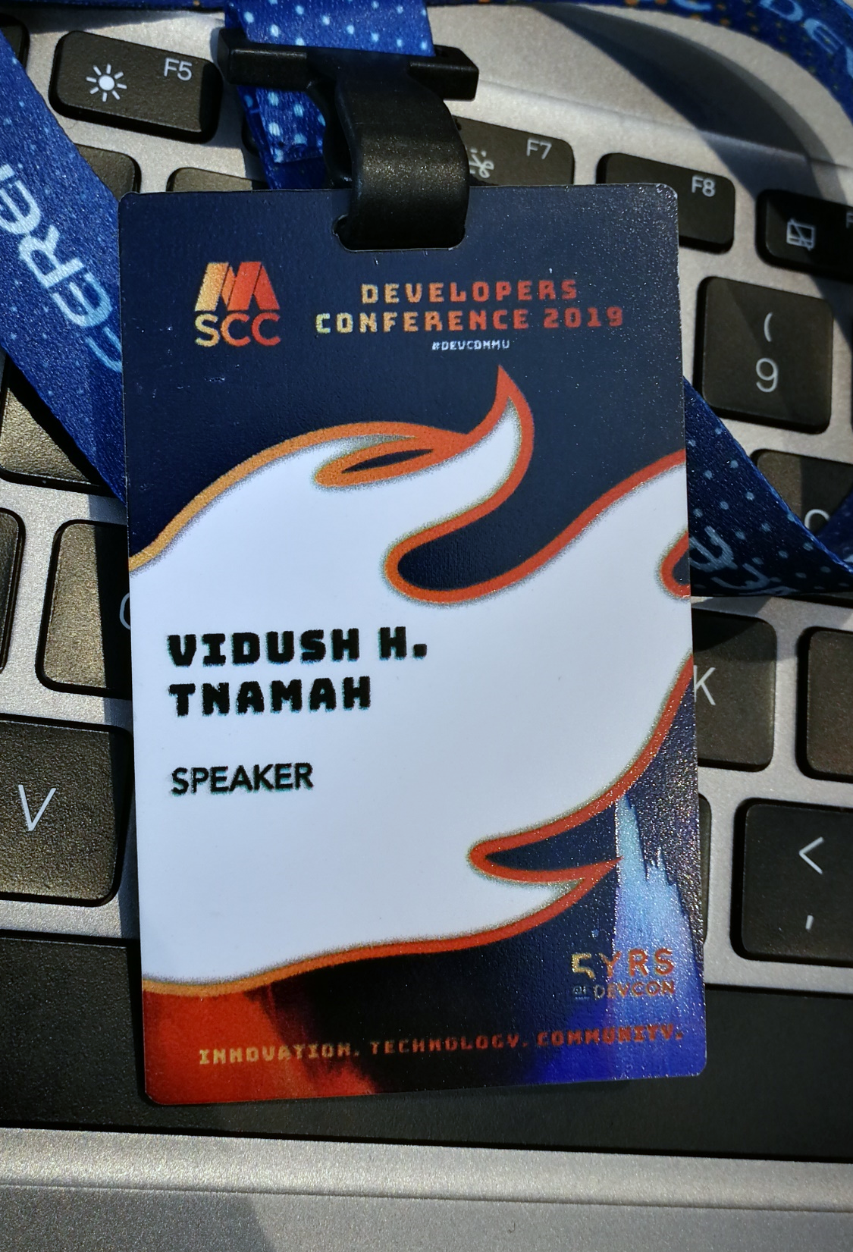
VIDUSH H. NAMAH
DIGITAL ENTREPRENEUR
INDEPENDENT CONSULTANT
MOST RECENT ADVENTURE: CONSULTANT AT SDWORX

Slide 3

REACT NATIVE
BUILD NATIVE MOBILE APPS USING JAVASCRIPT AND REACT
Notes:
Presenter: Aanesa + Keshav

Slide 4
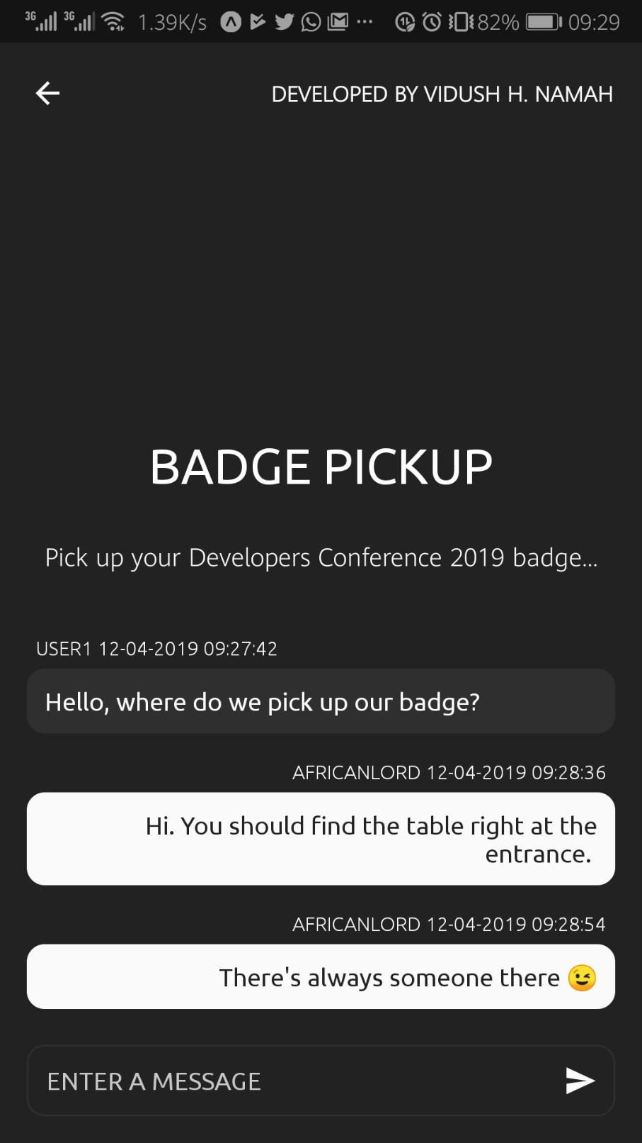
APPLICATION BREAK DOWN
VIEW | SCREEN | UI
DATA | STATE (GLOBAL VS LOCAL)
EVENTS | ACTIONS
Notes:
Presenter: Aanesa + Keshav

Slide 5
PART 1.1: VIEW
Notes:
Presenter: Aanesa + Keshav

Slide 6
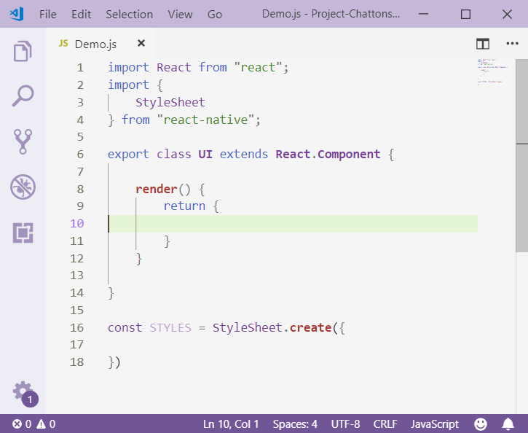
Notes:
Presenter: Aanesa + Keshav

Slide 7
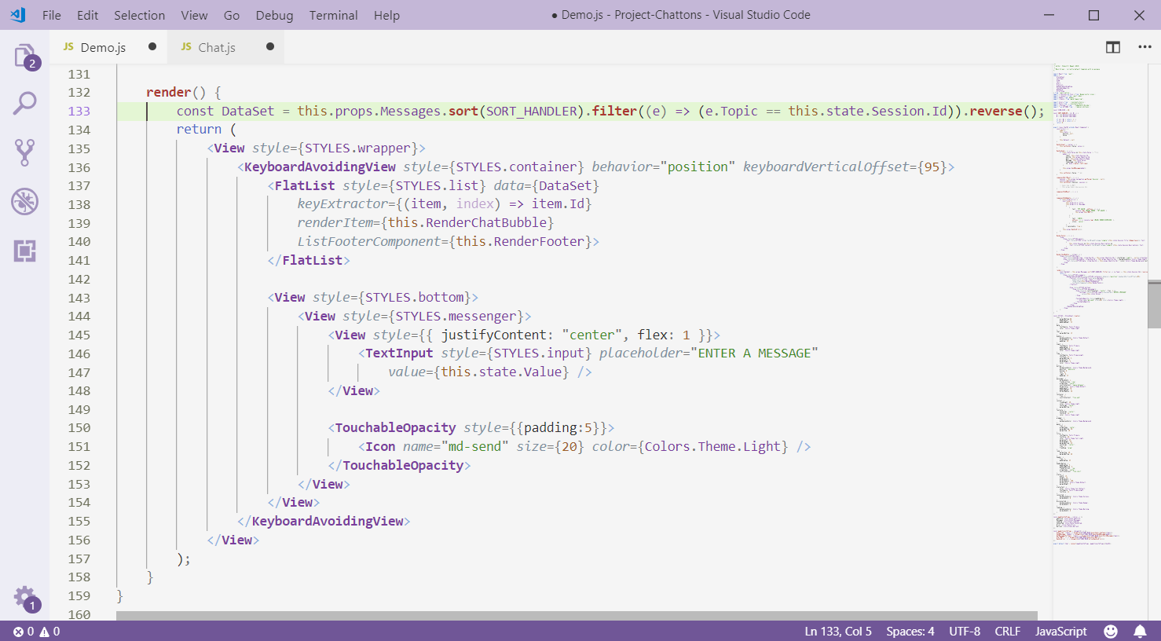
Notes:
Presenter: Aanesa + Keshav

Slide 8
PART 1.2: STYLING
Notes:
Presenter: Aanesa + Keshav

Slide 9
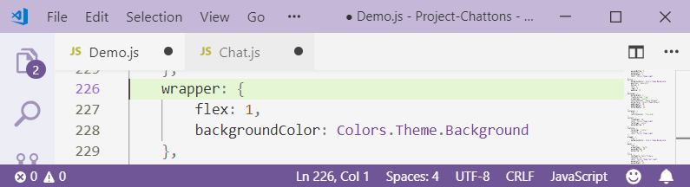
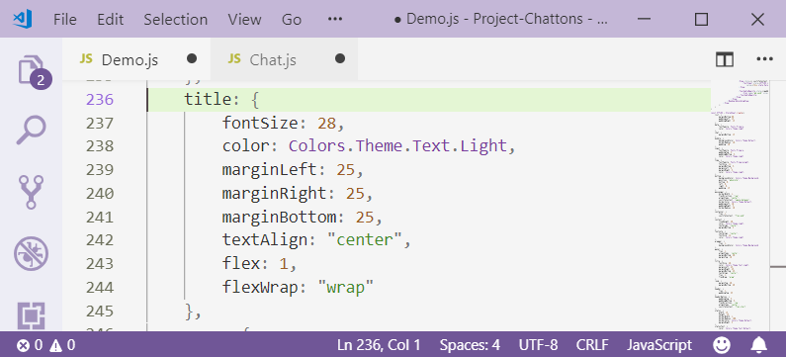
STYLING
Notes:
Presenter: Aanesa + Keshav

Slide 10
STYLING
Notes:
Presenter: Aanesa + Keshav

Slide 11
STYLING
Notes:
Presenter: Aanesa + Keshav

Slide 12
STYLING
Notes:
Presenter: Aanesa + Keshav

Slide 13
STYLING
Notes:
Presenter: Aanesa + Keshav

Slide 14

STYLING
Notes:
Presenter: Aanesa + Keshav

Slide 15
STYLING
Notes:
Presenter: Aanesa + Keshav

Slide 16
PART 2.1: LOCAL STATE
Notes:
Presenter: Aanesa + Keshav

Slide 17
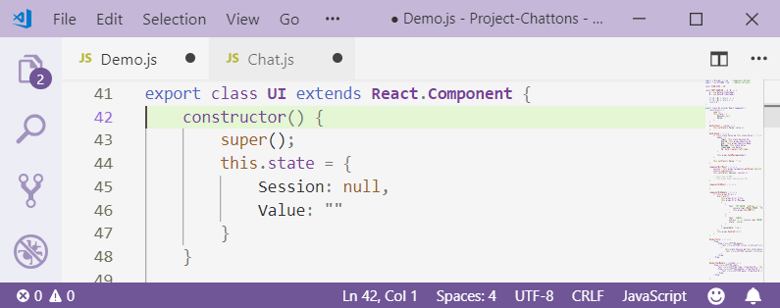
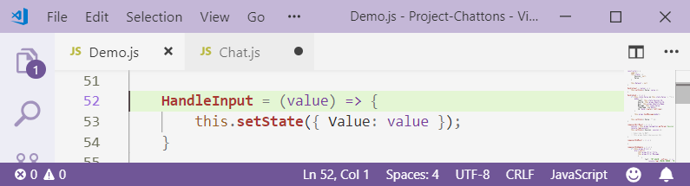
SETTING LOCAL STATE
Notes:
Presenter: Aanesa + Keshav

Slide 18
Notes:
Presenter: Aanesa + Keshav

Slide 19
I CANNOT SHOW THESE ON SLIDES…
PART 2.2: GLOBAL STATE (REDUX) PART 3.1: ACTIONS AND REDUCERS
Notes:
Presenter: Aanesa + Keshav

Slide 20
BUT I WILL TRY..
UPDATE
(REDUX) STATE
REDUCERS
I HOPE THIS IS CORRECT.
DISPATCHER
DISPATCH ACTION
(REDUX) STATE
SUBSCRIBE
VIEW
VIEW
RENDER
Notes:
Presenter: Aanesa + Keshav

Slide 21
I CANNOT SHOW THESE EITHER.. :/
PART 3.2: REDUX SAGA
PART 4 : PROPER STRUCTURE (?)
Notes:
Presenter: Aanesa + Keshav

Slide 22
BUT I WILL TRY..
REDUX
IT’S OK IF YOU DON’T GET IT.. I DON’T EITHER
DON’T TELL ANYONE
REDUX SAGA
WAITING FOR ACTION TYPE: A
WAITING FOR ACTION TYPE: B
WAITING FOR ACTION TYPE: C
DISPATCHER
SUBSCRIBE
VIEW
Notes:
Presenter: Aanesa + Keshav

Slide 23
VIDUSH H. NAMAH
DIGITAL ENTREPRENEUR
INDEPENDENT CONSULTANT
MOST RECENT ADVENTURE: CONSULTANT AT SDWORX

